Slide 1
Introductory Lecture – CSIT226/CSIT826
CSIT226/CSIT826

Slide 2
Dr. Mark Freeman
School of Computing and Information Technology
Faculty of Engineering and Information Sciences

Slide 3
Any sufficiently advanced technology is indistinguishable from magic. – Arthur C. Clark
Line at the start of the most recent telstra commercial

Slide 4
This Week
Background
About Me
Subject Overview
Assessments
Moodle Site
Subject Interaction
Content Introduction
Human Computer Interaction

Slide 5
About the Coordinator – Dr Mark Freeman
Senior Lecturer
Teaching in 2016
CSIT321: Project (Annual and Spring2016/Autumn2017)
CSIT114: Systems Analysis (Autumn)
CSIT226: Human Computer Interaction
Other roles
Academic Program Director – INTI, Malaysia
Chair of Industry and Community Engagement (SISAT)
Degree Director – Master of Information Technology Management
Chair of Advisory Panel – UOWCollege Dip.IT
Board Member – ICT Illawarra

Slide 6
About the Coordinator – Dr Mark Freeman
Research interests:
Human-Computer Interaction and User Experience (current focus on mobile systems and systems in early childhood)
User learning and cognitive abilities when interacting with systems
Social Networking Technologies
Qualifications:
Doctor of Philosophy (UOW)
Master of Education (Higher Education) with Distinction (UOW)
Bachelor of Information and Communication Technology (Software Development) Honours I (UOW)

Slide 7


Slide 8
 | Topic | Reading
1 | Subject Overview and Introduction to HCI | Chapter 1
2 | User-Centred Design | Chapter 2
3 | User Interaction | Chapters 3 & 4
4 | User Interfaces | Chapters 5 & 6
5 | Information Presentation and Navigation | No Readings
6 | Accessibility and Special Issues in HCI | No Readings
7 | Interaction Design and Development I: Data Gathering and Analysis | Chapters 7 & 8
8 | Interaction Design and Development II: Requirements and Modelling | Chapters 9 & 10
9 | Interaction Design and Development III: Prototyping | Chapters 11 & 12
10 | No Classes: Public Holiday | No Readings
11 | Usability Evaluation Methods I | Chapter 13
12 | Usability Evaluation Methods II | Chapters 14 & 15
13 | Future HCI & Subject Revision | No Readings

Slide 9
Subject Description
The subject provides students with an understanding of Human Computer Interaction (HCI) principles and practices, and how to apply them in the context of developing usable interactive computer applications and systems. The subject also emphasises the importance of taking into account contextual, organisational, and social factors in the design of computer systems. Students will be taken through the analysis, design, development, and evaluation of user interfaces. They will acquire hands-on design skills through an interaction design project. The subject will cover topics including user-centred design, the development process, prototyping, usability testing, measuring and evaluating the user experience and accessibility.

Slide 10
Subject Learning Outcomes (SLOs)
On successful completion of this subject, students will be able to:
Identify and describe HCI principles and design issues.
Discuss and justify HCI solutions based on design principles.
Demonstrate an understanding of the HCI design process.
Acquire skills to design and implement user-centred design.
Select and use suitable methods of measuring and evaluating the user experience.

Slide 11
Health and Safety
Information for Students
Commencement of Session

Slide 12
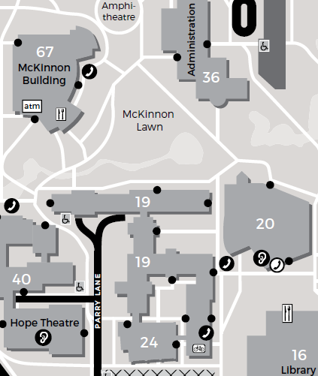
What to do an emergency? KEEP CALM – STAY SAFE
If the alarm sounds or you are notified to evacuate:
Follow instructions of building warden or lecturer
Leave by the nearest safe fire exit
Proceed to emergency evacuation point
Await further instructions.
If required to take shelter:
Follow instructions of building warden or lecturer
Lock door and seek refuge
Await further instructions.
The nearest assembly area for this building is:
Emergency
Evacuation
Point E

Slide 13
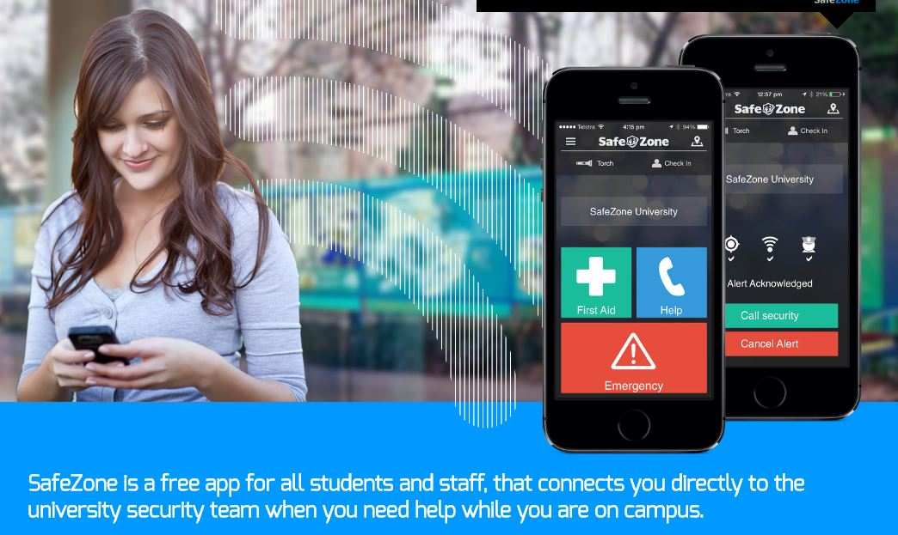
Need assistance on campus? WE ARE HERE TO HELP
If you require first aid or medical assistance while on campus:
- Locate a first aid officer, or
Call UOW Security on 4221 4900, or
Use First Aid or Emergency buttons on SafeZone App available free for iOS, Android and Windows.

Slide 14

Smoke-Free University SAY GOODBYE TO SECONDHAND SMOKE
All University public areas including buildings, eating areas, grounds, pathways and transport stops will be smoke-free from 25 July 2016.
Please co-operate with this new policy to help make our campus healthier for everyone.
For more information:
go.uow.edu.au/smoke-free

Slide 15
For more information: go.uow.edu.au/safeatwork

Slide 16
Subject Overview

Slide 17
Tutorials --
More will be available shortly.
Start in week 2.

Slide 18

Text Book
Preece, J., Rogers, Y. & Sharp, H. (2015). Interaction Design: Beyond Human-computer Interaction (4th Edition). Wiley.

Slide 19
Other Resources
Documents listed on Moodle
Library books and ebooks
Web Sites
Standards

Slide 20
Assessment Schedule
ASSESSMENT | % | GROUP/ INDIVIDUAL | DUE DATE
Individual Quizzes | 10% (5% each) | Individual | Completed on eLearning by Friday weeks 3 & 9 (at 1700hrs)
Group Project - Part A - User data gathering - Requirements identification | 10% | Group | Friday 16 September (submit to eLearning at 1700hrs)
Group Project - Part B - Prototyping - Development | 20% | Group | Friday 14 October (submit to eLearning at 1700hrs)
Group Project - Part C - Presentation | 10% | Group | Conducted in Tutorials Weeks 12 & 13
Final Examination | 50% | Individual | During University examination period

Slide 21
Individual Quizzes
Quizzes will be conducted online and due on Friday at 1700hrs of weeks 3 & 9.
The quizzes test your knowledge and understanding of the material presented in the subject.

Slide 22
Group project
In groups of 4-5 students you will be given an open complex information systems problem.
You will initially need to perform user data gathering, elicitation and analysis [Part A]; then based on feedback develop a system design, prototyping and mock-ups of how users would interact with the system [Part B]. You will then present your solution to the class [Part C].
Assessment for the project is based on the argument(s) developed and sustained for your system, the quality of the research used to support the system developed, the ability to interpret what you have researched and the fluency of your written report.
You will be required to review each group members' performance through both self- and peer- assessment). The subject coordinator will use this information to gain an understanding of individual participation and group contribution towards the project. This will also be used in determining individual marks for the group project (members will not necessarily be given the same marks).

Slide 23
Final examination
The final examination tests your knowledge and understanding of all material presented in this subject.

Slide 24
Electronic Submission of Assessment Items
Unless otherwise notified by the subject coordinator, all written assignments must be submitted electronically.
Assessment General:
Submission of assessment items via email will not be accepted.
Students must keep an electronic copy of all work/assignments handed in.
Technical Fail
To be eligible for a Pass in this subject a student must achieve a mark of at least 40% in the Final Exam. Students who fail to achieve this minimum mark & would have otherwise passed may be given a TF (Technical Fail) for this subject.

Slide 25
Procedure for the return of assessment items
All assignments will be returned within 2 weeks of their submission.
Electronic assessment items will be returned electronically with feedback via eLearning.
Penalties for late submission of assessment items:
Penalties apply to all late work, except if student academic consideration has been granted. Late submissions will attract a penalty of 25% of the assessment mark. This amount is per day including weekends. Work more than 4 days late will be awarded a mark of zero.

Slide 26
Moodle Site
Live demonstration

Slide 27
Human-Computer Interaction (HCI)
What is HCI?
What happens when A human and a computer interact?
Why are we studying HCI?

Slide 28
Pair Discussion
What is your favourite technology? Why?
What is your least favourite technology? Why?

Slide 29
Definitions
“Human-computer interaction is a discipline concerned with the design, evaluation and implementation of interactive computing systems for human use and with the study of major phenomena surrounding them.” (Hewett, Baecker, Card, Carey, Gasen, Mantei, Perlman, Strong and Verplank 1992)
Usability: “The extent to which a product can be used by specified users to achieve specified goals with effectiveness, efficiency and satisfaction in a specified context of use.” ISO 9241-11
“User experience (UX) is an approach to product development that incorporates direct user feedback throughout the development cycle (human-centered design) in order to reduce costs and create products and tools that meet user needs and have a high level of usability (are easy to use).” (UXPA 2013)

Slide 30
Definitions
“Human-centered design is characterised by: the active involvement of users and a clear understanding of user and task requirements; an appropriate allocation of function between users and technology; the iteration of design solutions; multi-disciplinary design.”- ISO 13407
Interaction Design: “Designing interactive products to support the way people communicate and interact in their everyday and working lives.” (Preece, Sharp and Rogers 2015)

Slide 31
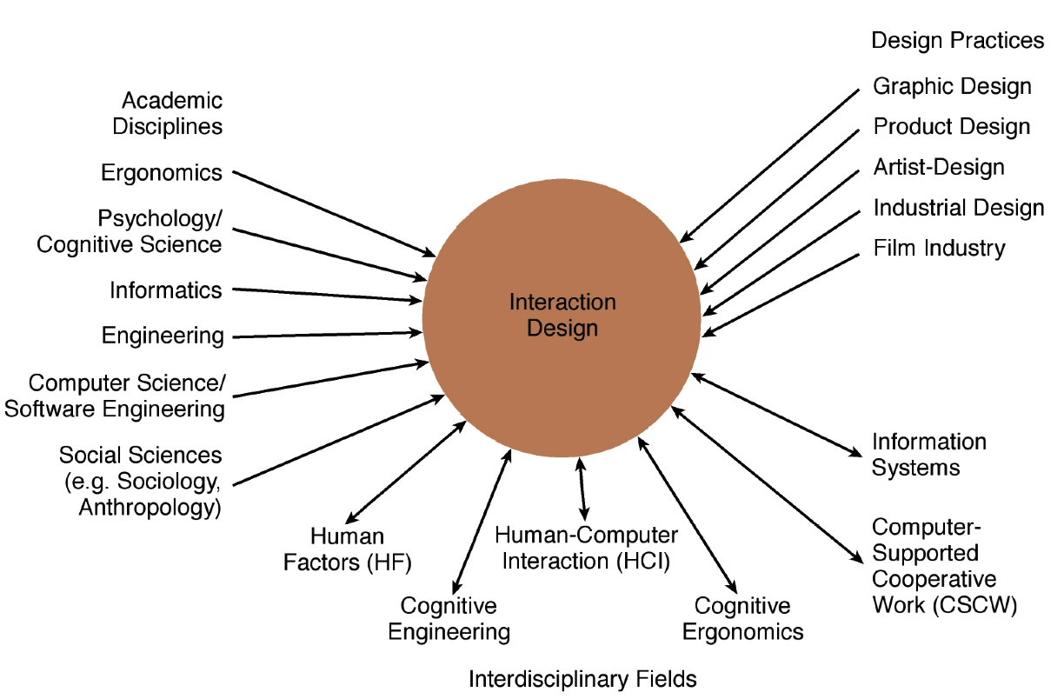
Interaction Design (Figure 1.3)

Slide 32
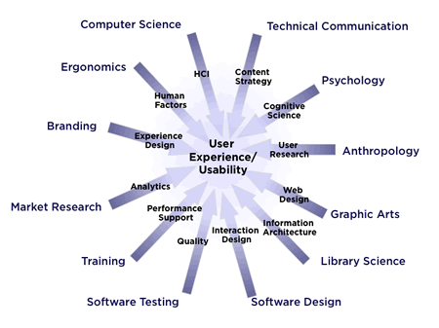
UXPA: User Experience (UX) professional

Slide 33
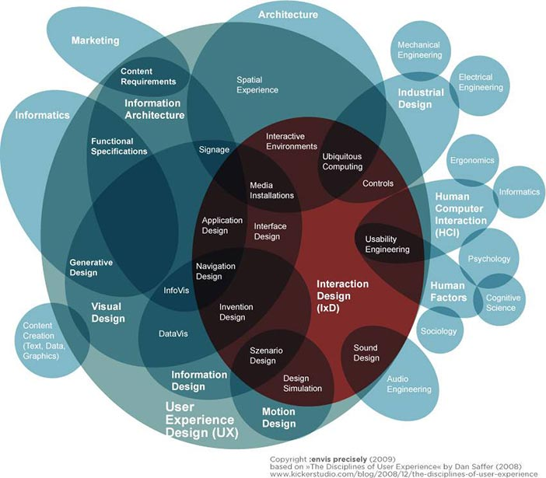
Disciplinary knowledge and skills

Slide 34
Working in multidisciplinary teams
Many people from different backgrounds involved
Different perspectives and ways of seeing and talking about things
Benefits
more ideas and designs generated
Disadvantages
difficult to communicate and progress forward the designs being create

Slide 35
Know the User!
Issues:
Assume all users are the same
Assume users are like the system designer
What do users (Humans) do well?

Slide 36
What do professionals do in the ID business?
Interaction designers - people involved in the design of all the interactive aspects of a product
Usability engineers - people who focus on evaluating products, using usability methods and principles
Web designers - people who develop and create the visual design of websites, such as layouts
Information architects - people who come up with ideas of how to plan and structure interactive products
User experience designers (UX) - people who do all the above but who may also carry out field studies to inform the design of products

Slide 37
User Experience (UX)
How a product behaves and is used by people in the real world
the way people feel about it and their pleasure and satisfaction when using it, looking at it, holding it, and opening or closing it
“every product that is used by someone has a user experience: newspapers, ketchup bottles, reclining armchairs, cardigan sweaters.” (Garrett, 2010)
“all aspects of the end-user's interaction with the company, its services, and its products. (Nielsen and Norman, 2014)
Cannot design a user experience, only design for a user experience

Slide 38
What is involved in the process of interaction design?
Establishing requirements
Developing alternatives
Prototyping
Evaluating
Core characteristics
Users should be involved through the development of the project
Specific usability and user experience goals need to be identified, clearly documented and agreed at the beginning of the project
Iteration is needed through the core activities

Slide 39
Why go to this length?
Help designers:
understand how to design interactive products that fit with what people want, need and may desire
appreciate that one size does not fit all
e.g., teenagers are very different to grown-ups
identify any incorrect assumptions they may have about particular user groups
e.g., not all old people want or need big fonts
be aware of both people’s sensitivities and their capabilities

Slide 40
Accessibility
Degree to which a product is usable and accessible by as many people as possible
Focus on disability:
Have a mental or physical impairment
This has an adverse affect on their everyday lives
It is long term

Slide 41
Usability goals
Effective to use
Efficient to use
Safe to use
Have good utility
Easy to learn
Easy to remember how to use

Slide 42
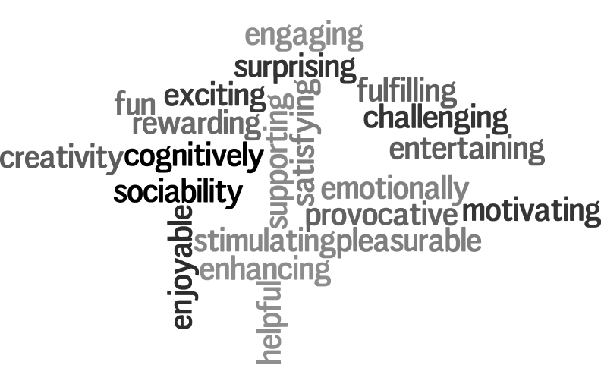
User experience goals

Slide 43
Usability and user experience goals
Selecting terms to convey a person’s feelings, emotions, etc., can help designers understand the multifaceted nature of the user experience
How do usability goals differ from user experience goals?
Are there trade-offs between the two kinds of goals?
e.g. can a product be both fun and safe?
How easy is it to measure usability versus user experience goals?

Slide 44
Design principles
Generalizable abstractions for thinking about different aspects of design
The do’s and don'ts of interaction design
What to provide and what not to provide at the interface
Derived from a mix of theory-based knowledge, experience and common-sense
Visibility
Feedback
Constraints
Consistency

Slide 45
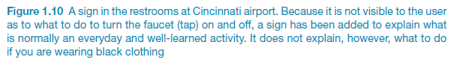
What do I do if I am wearing black?
Invisible automatic controls can make it more difficult to use

Slide 46
Constraints
Restricting the possible actions that can be performed
Helps prevent user from selecting incorrect options
Physical objects can be designed to constrain things
e.g. only one way you can insert a key into a lock

Slide 47
Consistency
Design interfaces to have similar operations and use similar elements for similar tasks
For example:
always use ctrl key plus first initial of the command for an operation – ctrl+C, ctrl+S, ctrl+O
Main benefit is consistent interfaces are easier to learn and use
When consistency breaks down
What happens if there is more than one command starting with the same letter?
e.g. save, spelling, select, style
Have to find other initials or combinations of keys, thereby breaking the consistency rule
e.g. ctrl+S, ctrl+Sp, ctrl+shift+L
Increases learning burden on user, making them more prone to errors

Slide 48
Internal and external consistency
Internal consistency refers to designing operations to behave the same within an application
Difficult to achieve with complex interfaces
External consistency refers to designing operations, interfaces, etc., to be the same across applications and devices
Very rarely the case, based on different designer’s preference

Slide 49
Keypad numbers layout
A case of external inconsistency
(a) phones, remote controls
(b) calculators, computer keypads
1
2
3
7
8
9
4
5
6
4
5
6
7
8
9
1
2
3
0
0

Slide 50
Affordances: to give a clue
Refers to an attribute of an object that allows people to know how to use it
e.g. a mouse button invites pushing, a door handle affords pulling
Norman (1988) used the term to discuss the design of everyday objects
Since has been much popularised in interaction design to discuss how to design interface objects
e.g. scrollbars to afford moving up and down, icons to afford clicking on

Slide 51
What does ‘affordance’ have to offer interaction design?
Interfaces are virtual and do not have affordances like physical objects
Norman argues it does not make sense to talk about interfaces in terms of ‘real’ affordances
Instead interfaces are better conceptualized as ‘perceived’ affordances
Learned conventions of arbitrary mappings between action and effect at the interface
Some mappings are better than others

Slide 52
Key points
Interaction design is concerned with designing interactive products to support the way people communicate and interact in their everyday and working lives
It is concerned with how to create quality user experiences
It requires taking into account a number of interdependent factors, including context of use, type of activities, cultural differences, and user groups
It is multidisciplinary, involving many inputs from wide-reaching disciplines and fields

Slide 53
Questions

